Slide 1
SAT/ACT Overview
RISE Philadelphia PCOM
Presented by: Amanda Nguyen

Slide 2
TABLE OF CONTENTS
What are the SAT/ACT?
General Timeline
SAT Overview
ACT Overview

Slide 3
WHAT ARE THE SAT AND ACT?
They are standardized entrance exams that are used by most colleges and universities to make admission decisions.
The purpose is to measure college readiness and provide a common data point to compare applicants.
Which one should I take?
It’s up to you! Most colleges/universities accept both exams

Slide 4
Benefits of Taking the Exam
Can help you with qualifying for scholarships
It can help colleges find YOU if you opt for the Student Search Service (registration)
Can help guide your college choices

Slide 5
General Timeline
Both exams are offered 7x each year on Saturdays
SAT: August, October, November, December, March, May, June
ACT: September, October, December, February, April, June, July
Registration for the Exam
Applications for Colleges open
Exam Date(s)
Spring of Junior year/Fall of senior year
Up to a year in advance
August 1 of each Year

Slide 6
Overview of the SAT

Slide 7
Exam Structure & Format
Length: 3 hours
Sections
Math
Calculator
No calculator
Evidence-based reading and writing
Reading
Writing & Language
Highest score: 1600
Each section 200-800 pts

Slide 8
Math Section
Math
58 multiple choice questions
20 - no-calculator
38 calculator-allowed
80 minutes
25 minutes no-calculator
55 minutes calculator-allowed
Algebra I and II, geometry, some trigonometry

Slide 9
Evidence-based Reading & Writing Section
Reading
52 multiple-choice questions
65 minutes
Passages or paired passages (literature, historical documents, social sciences, natural sciences)
Writing and language
44 multiple-choice questions
35 minutes
Grammar, vocabulary in context, and editing skills

Slide 10
How to register for the SAT
Deadlines
Cost
5 weeks before each test date
$60
Fees
Changing test center - $25
Cancelation - $25
Late Cancelation - $35
Late Registration - $30

Slide 11
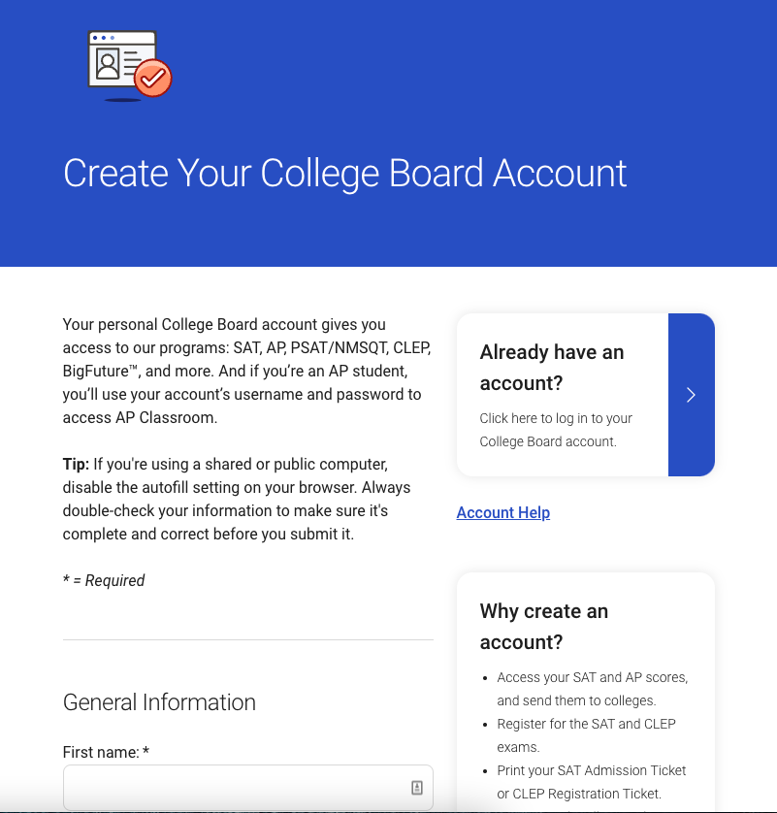
Step-by-step Guide to Registration
Create a CollegeBoard account

Slide 12
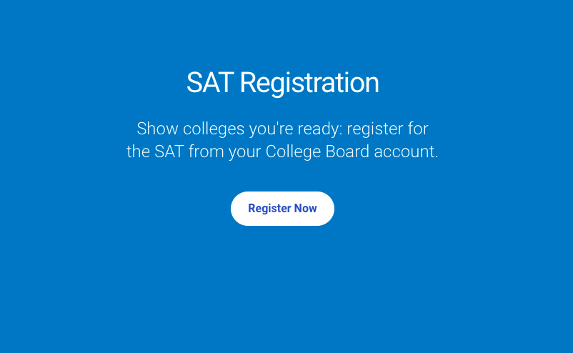
Step-by-step Guide to Registration
2) Visit SAT registration page and click “Register Now”

Slide 13
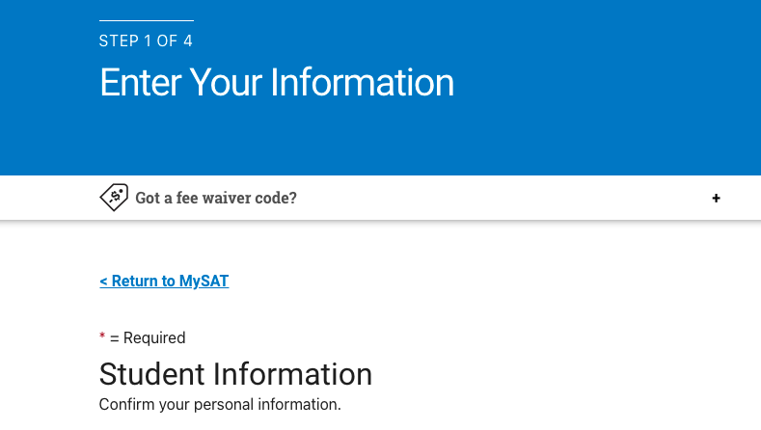
Step-by-step Guide to Registration
3) Enter your personal information
Digital photo or copy of your ID
GPA
Academic Interests
Household Income
etc.

Slide 14
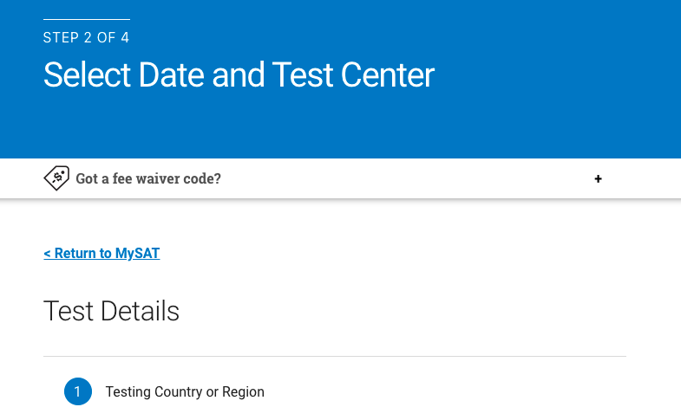
Step-by-step Guide to Registration
4) Select your test date and center
You can use the SAT test center search tool to look for a test date and center by zip code, state, city, or distance from your location
Once you find a test date and center that fits your schedule click register for the SAT

Slide 15
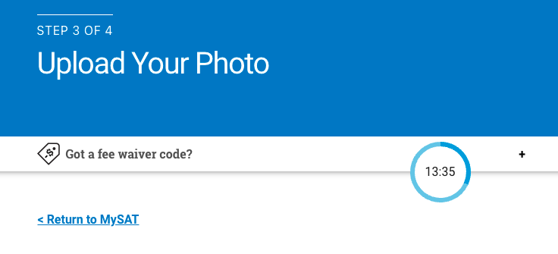
Step-by-step Guide to Registration
5) Upload your photo of yourself, it is needed to match your ID on testing day

Slide 16
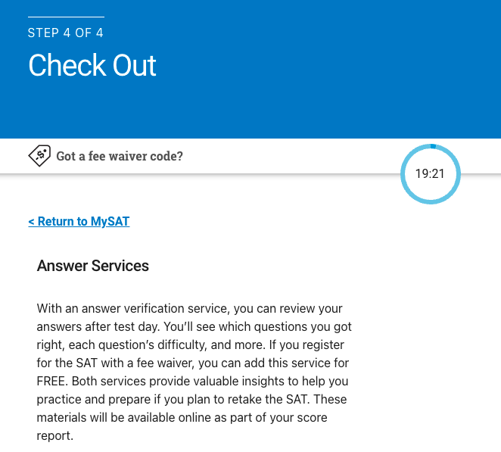
Step-by-step Guide to Registration
6) Add optional services and practice materials
You can choose to add answer services to review answers after the test for an additional $16 and/or SAT practice materials for $29.99

Slide 17
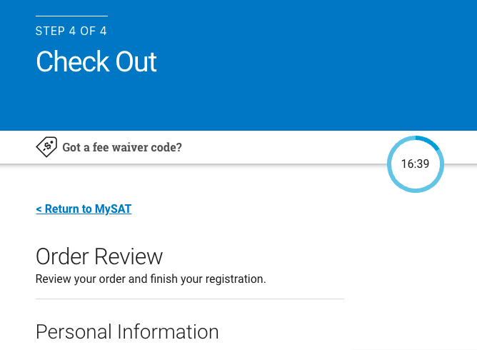
Step-by-step Guide to Registration
7) Review your order and confirm your SAT registration

Slide 18
Overview of the ACT

Slide 19
Exam Structure & Format
Length: 2h 55min (+40 min if taking ACT writing)
Sections
English
Math
Reading
Science
Writing (optional)
Highest score: 36

Slide 20
Section Breakdown
Section | # of Questions & Time limit | Content & Skills Covered
English | 75 questions 45 minutes | Grammar & usage, Punctuation, Sentence structure, Organization, Style & strategy
Math | 60 questions 60 minutes | Pre-algebra, elementary algebra, intermediate algebra Coordinate geometry, Plane geometry, trigonometry
Reading | 40 questions 35 minutes | Reading comprehension
science | 40 questions 35 minutes | Interpretation, analysis, evaluation, reasoning, problem-solving
Writing (optional) | 1 essay in 40 min. | Writing skills

Slide 21
How to register for the ACT
Deadlines
Method
4-5 weeks before each test date
Online or by-mail
Fees
Without writing - $63
With writing - $88
Test option change - $25
Change test date or center - $40
Cancel registration - nonrefundable
Late registration - $36

Slide 22
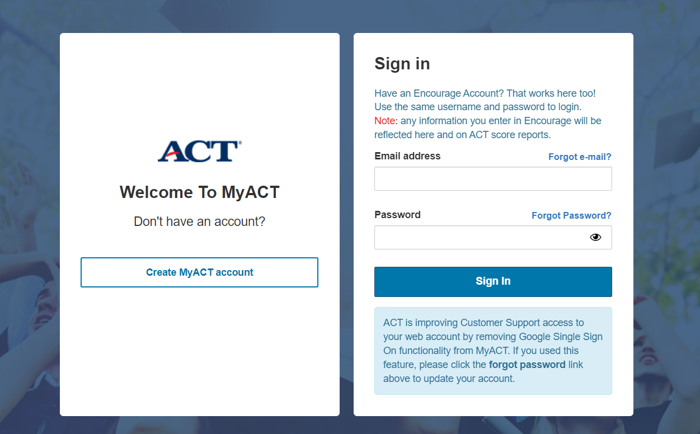
Step-by-step Guide to Registration
Create an account on ACT.org
Make a MyACT account
Provide full name, date of birth, email, country, phone number, agree to terms and conditions
Must verify details through an email or text

Slide 23
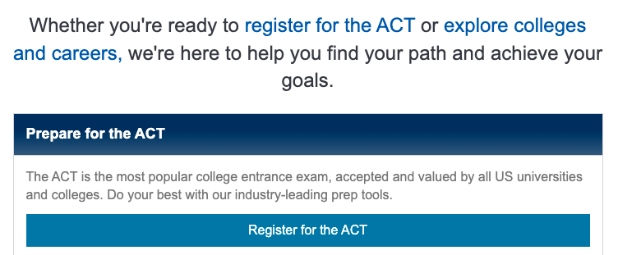
Step-by-step Guide to Registration
2) Visit your ACT Dashboard and Click “Register for the ACT”
From there you can select whether you will be testing inside or outside the U.S. and indicate if you need any accommodations during the exam for a documented disability.
You will also decide if you plan on taking the ACT with or without the optional writing component

Slide 24
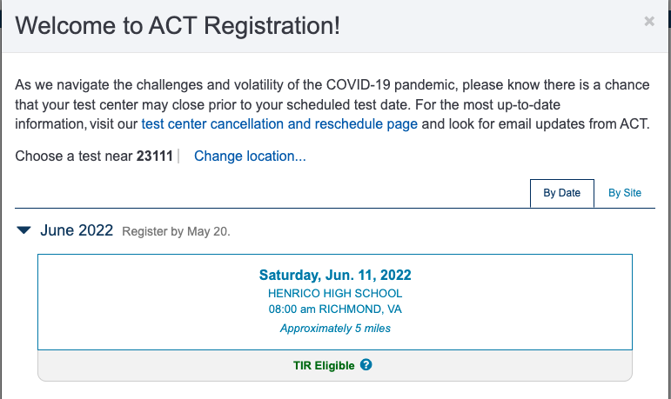
Step-by-step Guide to Registration
3) Choose your test center and test date
By test center or test date

Slide 25
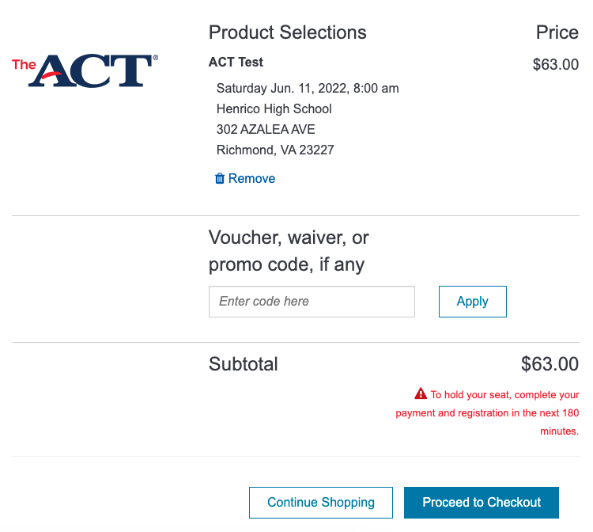
Step-by-step Guide to Registration
4) Review your selections

Slide 26
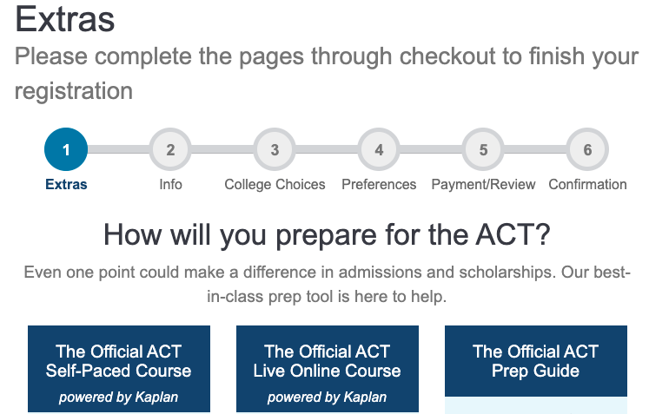
Step-by-step Guide to Registration
5) Add services and practice materials (optional)
Some practice materials, tutoring services, and self-paced ACT prep courses are available and can be added for an additional fee.
You can also buy a test information release (TIR) for $30 that will provide you with a copy of your answers

Slide 27
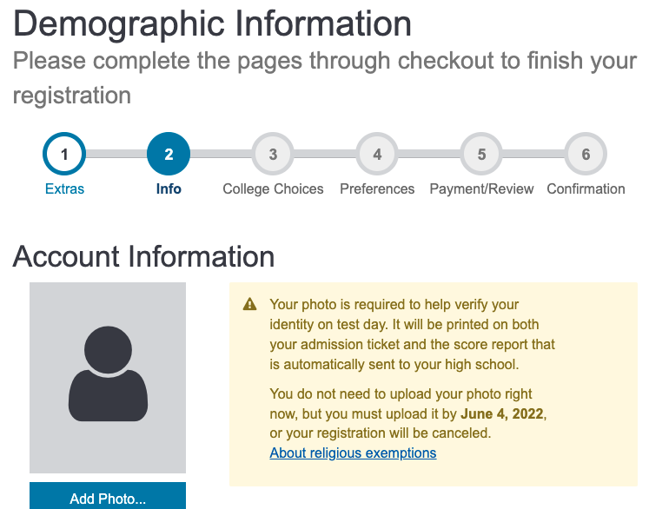
Step-by-step Guide to Registration
6) Add your photo ID and personal information

Slide 28
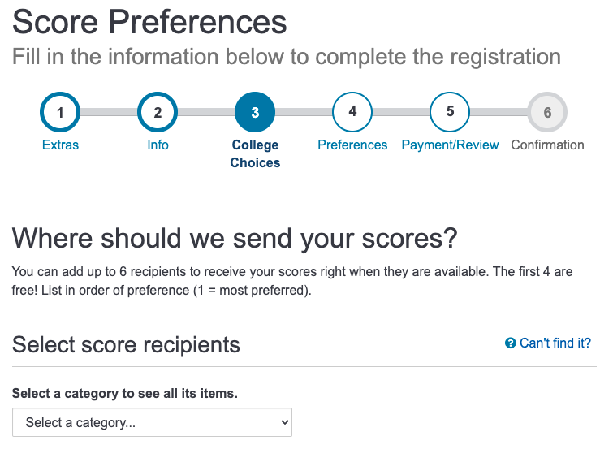
Step-by-step Guide to Registration
7) Indicate your college choices and score preferences (optional)
You have the option of listing your potential college choices so that your ACT score can be directly sent to these schools. You can send your score to up to 4 schools for free.
Students applying to highly competitive colleges may skip this step to ensure their score is strong enough before sending

Slide 29
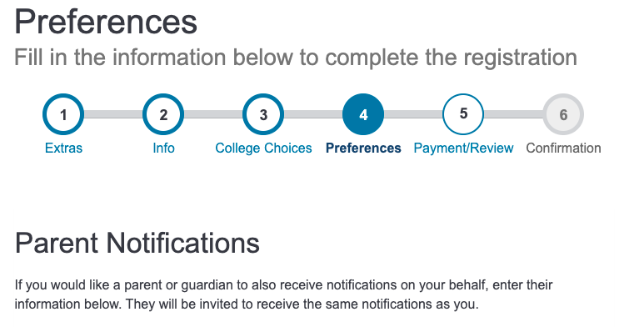
Step-by-step Guide to Registration
8) Enter your parent or guardian’s information (optional)

Slide 30
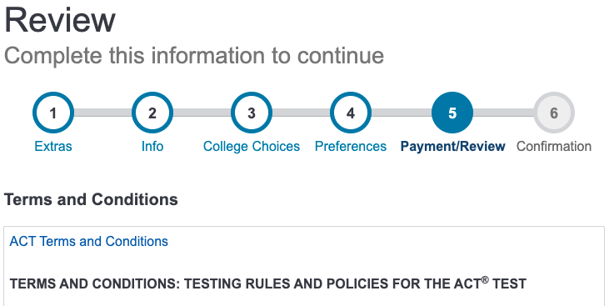
Step-by-step Guide to Registration
9) Submit payment and confirm your ACT registration

Slide 31
Some Newer Changes
Most colleges now however are test-optional or test-blind. This was partly due to the COVID-19 pandemic that temporarily shut down testing sites. This means that the SAT or ACT is no longer required for admission to these schools
However some top colleges and universities still require applicants to submit SAT or ACT score so you should make sure to research the requirements for the schools you are applying to.
Starting in fall 2023, all students taking PSAT-related assessments will take digital tests. SAT school day and SAT weekend administrations in the U.S. will still be paper and pencil.
However starting spring 2024, all students will take the full SAT assessments digitally

Slide 32
RESOURCES
Test Prep Resources
What is the difference between SAT and ACT?
Princeton Review’s SAT vs ACT comparison for students
US news’ ACT vs SAT comparison for students
PrepScholar’s SAT VS ACT comparison for students
SAT
Khan Academy
Strategies and samples of practice questions for the reading, writing, math, and essay sections of the SAT with additional free practice exams
Varsity tutors (classes)
Free live SAT online classes
Princeton review (practice materials)
Free SAT practice events, seminars, and exams
ACT
Free official ACT practice tests from PrepScholar
Tutoring with RISE Philly
For more personalized tutoring and session contact rise.philly.2020@gmail.com

Slide 33
Final Message…
Research into the schools you are thinking of applying to
Decide whether or not taking the SAT or ACT is the right choice for you
Choose when to take the exam
And lastly… start prepping! You got this!

